Slide 1
Ben Bromhead
Cassandra… Every day I’m scaling

Slide 2
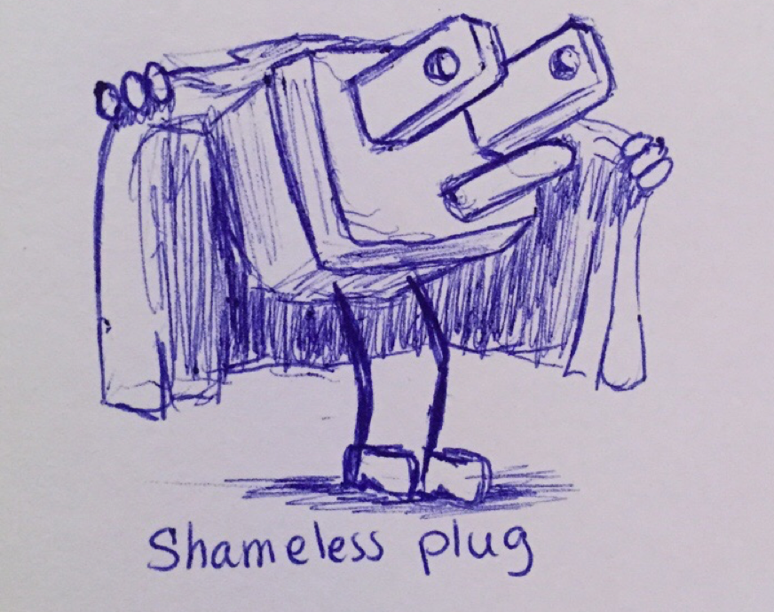

Slide 3
Who am I and What do I do?
Co-founder and CTO of Instaclustr -> www.instaclustr.com
Instaclustr provides Cassandra-as-a-Service in the cloud.
Currently support AWS, Azure, Heroku, Softlayer and Private DCs with more to come.
Approaching 1000 nodes under management
Yes… we are hiring! Come live in Australia!

Slide 4
1 | Why scaling sucks in Cassandra
2 | It gets better
3 | Then it gets really awesome

Slide 5
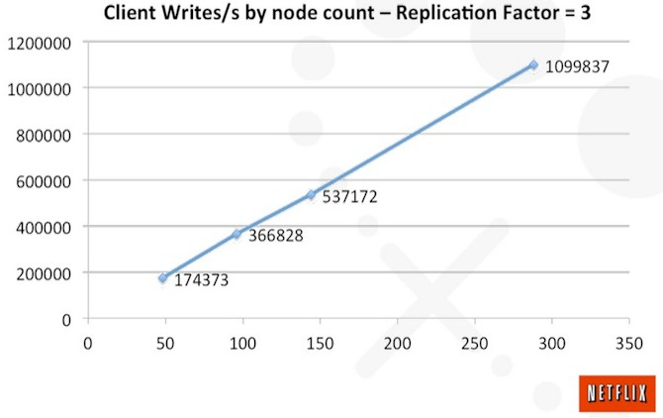
Linear Scalability – In theory

Slide 6

Linear Scalability – In practice

Slide 7
What’s supposed to happen
Scaling Cassandra is just “bootstrap new nodes”
That works if your cluster is under provisioned and has 30% disk usage

Slide 8
What actually happens
Add 1 node
Bootstrapping node fails (1 day)
WTF - Full disk on bootstrapping node? (5 minutes)
If STCS run SSTableSplit on large SSTables on original nodes (2 days)
Attach super sized network storage (EBS) and bind mount to bootstrapping node.

Slide 9
What actually happens
Restart bootstrapping process
Disk alert 70% (2 days later)
Throttle streaming throughput to below compaction throughput
Bootstrapping finishes (5 days later)
Cluster latency spikes cause bootstrap finished but their was a million compactions remaining
Take node offline and let compaction finish
Run repair on node (10 years)
Add next node.

Slide 10

What actually happens

Slide 11
Scalability in Cassandra sucks
Soo much over streaming
LCS and Bootstrap – Over stream then compact all the data!
STCS and bootstrap – Over stream all the data and run out of disk space

Slide 12
Scalability in Cassandra sucks
No vnodes? – Can only double your cluster
Vnodes? – Can only add one node at a time
Bootstrap – Fragile and not guaranteed to be consistent

Slide 13
Why does it suck for you
Your database never meets your business requirements from a capacity perspective (bad) and if you try…
You could interrupt availability and performance (really bad)
You could loose data (really really bad)

Slide 14
How did it get this way?
It’s actually a hard problem:
Moving large amounts of data between nodes requires just as much attention to it from a CAP perspective as client facing stuff.
New features don’t tend to consider impact on scaling operations
Features that help ops tends to be less sexy

Slide 15
Does it get better?
Yes!

Slide 16
Does it get better? Consistent bootstrap
Strongly consistent membership and ownership – CASSANDRA-9667
Using LWT to propose and claim ownership of new token allocations in a consistent manner
Work in progress
You can do this today by pre-assigning non-overlapping (inc replicas) vnode tokens and using cassandra.consistent.simultaneousmoves.allow=true as a JVM property before bootstrapping your nodes

Slide 17
Does it get better? Bootstrap stability
Keep-alives for all streaming operations – CASSANDRA-11841
Currently implements a timeout, you can reduce this to be more aggressive, but large SSTables will then never stream
Resummable bootstrap – CASSANDRA-8942 & CASSANDRA-8838
You can do this in 2.2+
Incremental bootstrap – CASSANDRA-8494
Being worked on, hard to do with vnodes right now (try it… the error message uses the word “thusly”), instead throttle streaming and uncap compaction to ensure the node doesn’t get overloaded during bootstrap

Slide 18
Can we make it even better?
Yes!

Slide 19
Can we make it even better?
Let’s try scaling without data ownership changes
Take advantage of Cassandras normal partition and availability mechanisms
With a little help from our cloud providers!

Slide 20
Introducing token pinned scaling
Probably needs a better name
Here is how it works

Slide 21
Introducing token pinned scaling
With the introduction of:
Partitioning SSTables by Range (CASSANDRA-6696)
Range Aware Compaction (CASSANDRA-10540)
A few extra lines of code to save/load a map of token to disks (coming soon)
Cassandra will now keep data associated with specific tokens in a single data directory, this could let us treat a disk as a unit in which to scale around!
But first what do these two features actually let us do?

Slide 22
Introducing token pinned scaling
Before Partitioning SSTables by Range and Range Aware Compaction:
Disk0
Disk1
1 - 100
901 - 1000
1401-1500
SSTables

Slide 23
Introducing token pinned scaling
After Partitioning SSTables by Range and Range Aware Compaction:
Disk0
Disk1
1 - 100
901 - 1000
1401-1500
SSTables
Data within a token range is now kept on a specific disk

Slide 24
Introducing token pinned scaling
Your SSTables will converge to contain a single vnode range when things get big enough
Disk0
Disk1
1 - 100
901 - 1000
1401-1500
SSTables

Slide 25
Leveraging EBS to separate I/O from CPU
Amazon Web Services provides a networked attached block store called EBS (Elastic Block Store).
Isolated to each availability zone
We can attach and reattach EBS disk ad-hoc and in seconds/minutes

Slide 26
Adding it all together
Make each EBS disk a data directory in Cassandra
Cassandra guarantees only data from a specific token range will exist on a given disk
When throughput is low attach all disks in a single AZ to a single node, specify all the ranges from each disk via a comma separated list of tokens.
Up to 40 disks per instance!
When load is high, launch more instances and spread the disks across the new instances.

Slide 27



Adding it all together
Make each EBS disk a data directory in Cassandra
sda
sdb
sdc
Amazon EBS
sdd
sde
sdf

Slide 28
Adding it all together
Cassandra guarantees only data from a specific token range will exist on a given disk
Amazon EBS

Slide 29
Adding it all together
When throughput is low attach all disks in a single AZ to a single node
Amazon EBS
200 op/s

Slide 30
Adding it all together
When load is high, launch more instances and spread the disks across the new instances.
Amazon EBS
10,000 op/s

Slide 31
How it works - Scaling
Normally you have to provision your cluster at your maximum operations per second + 30% (headroom in case your get it wrong).
Provision enough IOPS, CPU, RAM etc
Makes Cassandra an $$$ solution
Provisioned workload
Actual workload

Slide 32


Slide 33
How it works - Scaling
Let’s make our resources match our workload
Provisioned IOPS workload
Provisioned CPU & RAM workload
Actual workload

Slide 34
How it works - Scaling
Let’s make our resources match our workload
Provisioned IOPS workload
Provisioned CPU & RAM workload
Actual workload

Slide 35
How it works - Consistency
No range movements! You don’t need a Jepsen test to see how bad range movements are for consistency.
Tokens and ranges are fixed during all scaling operations
Range movements are where you see most consistency badness in Cassandra (bootstrap, node replacement, decommission) and need to rely on repair.

Slide 36
How it works - Consistency
Treats Racks as a giant “meta-node”, network topology strategy ensures replicas are on different racks.
AWS Rack == AZ
As tokens for a node change based on the disk they have, replica topology stays the same
You can only swap disks between instances within the same AZ
Scale one rack at a time… scale your cluster in constant time!
If you want to do this with a single rack, you will have a bad time

Slide 37
How it works - Consistency
1,5,10
3, 22, 44
102,134,167
2,6,11
4,23,45
101,122,155
1,2,3,4,5,6,10,11,22,23,44,45,101 …

Slide 38
How it works - Consistency
1,5,10
3, 22, 44
102,134,167
2,6,11
4,23,45
101,122,155
1,5,10
3,22,44
102,134,167
2,6,11
4,23,45
101,122,155

Slide 39
How it works - TODO
Some issues remain:
Hinted handoff breaks (handoff is based on endpoint rather than token)
Time for gossip to settle on any decent sized cluster
Currently just clearing out the system.local folder to allow booting
Can’t do this while repair is running… for some people this is all the time
You’ll need to run repair more often as scaling intentionally introduces outages
Breaks consistency and everything where RF > number of racks (usually the system_auth keyspace).
More work needed!

Slide 40
How it works – Real world
No production tests yet ☹
Have gone from a 3 node cluster to a 36 node cluster in around 50 minutes.
Plenty left to optimize (e.g. bake everything into an AMI to reduce startup time)
Could get this down to 10 minutes per rack depending on how responsive AWS is!
No performance overhead compared to Cassandra on EBS.
Check out the code here: https://github.com/benbromhead/Cassandra/tree/ic-token-pinning

Slide 41

How it works – Real world
Really this is bending some new and impending changes to do funky stuff ☺

Slide 42

Questions?

Slide 43
Questions?

